Slide 1


Innovation Flows Here.

Slide 2
Airbnb NYC 2019 – Advanced Cloud-Based Data Analytics
DAMO-630 – Advanced Data Analytics
Presented by: Krishna Patel,
Vrund Patel,
Poojan Patel,
Dhruv Trivedi
Instrctor: Ali El-Sharif

Slide 3
Motivation & Objective
NYC is one of Airbnb’s largest and most competitive markets with thousands of listings.
Hosts face challenges in pricing, positioning, and standing out among similar listings.
The platform needs better market intelligence and personalised recommendations.
Objective: Build a cloud-based analytics pipeline to understand price & demand and support better listing recommendations.

Slide 4
Research Questions
Market Understanding: How do price, availability, and review activity across neighbourhoods and room types?
Scenario Exploration: can synthetic data mimic real patterns for safe “what-if” analysis?
Personalisation: given a guest’s budget and preferences, which listings are most suitable?

Slide 5
Dataset & Cloud Setup
Dataset: Airbnb New York City 2019 listings (one row per listing).
Key variables: location, room_type, price, minimum_nights, availability_365, reviews, host characteristics.
Cloud platform: Databricks Community Edition with PySpark and Python 3.
CSV uploaded to DBFS, registered as Spark table, analysed in Databricks notebooks.

Slide 6
Data Cleaning & Feature Engineering
Validated schema and converted price, reviews, availability to numeric types.
Handled missing reviews_per_month / last_review as “no reviews yet”.
Removed extreme outliers in price and minimum_nights.
Created features:
  Price per minimum stay
  Review intensity (reviews_per_month)
  Host scale (single vs multi-listing hosts)
  Neighbourhood and room type indicators.

Slide 7
Module 1 – Mining Large-Scale Datasets
Used PySpark DataFrames for all transformations and aggregations.
groupBy + aggregations to compute summary statistics by neighbourhood_group and room_type.
Spark SQL views enabled interactive queries and visualisations in Databricks.
Saved cleaned tables as Parquet for efficient reuse and scalability.

Slide 8
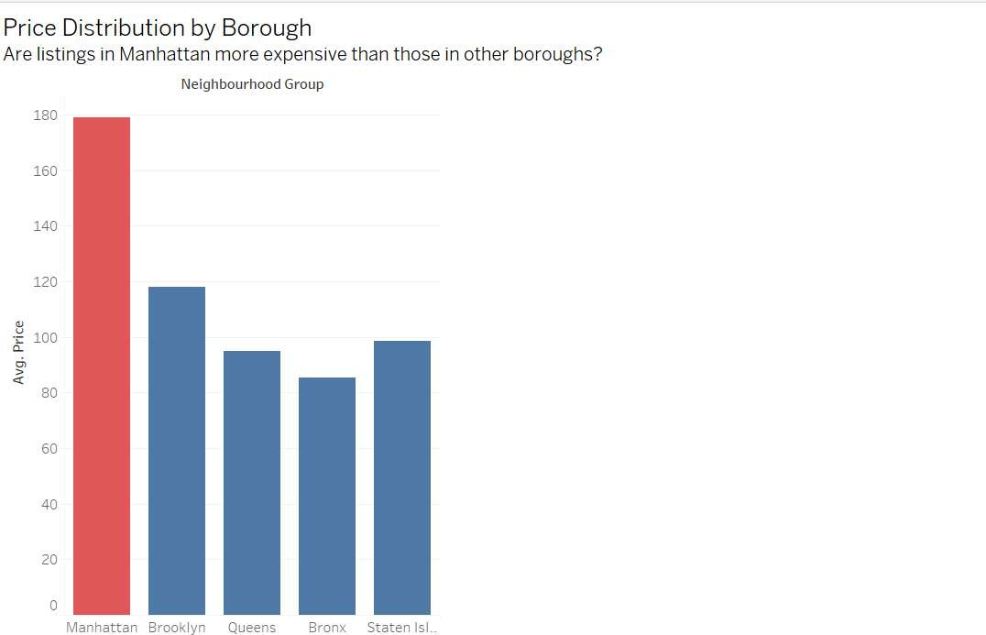
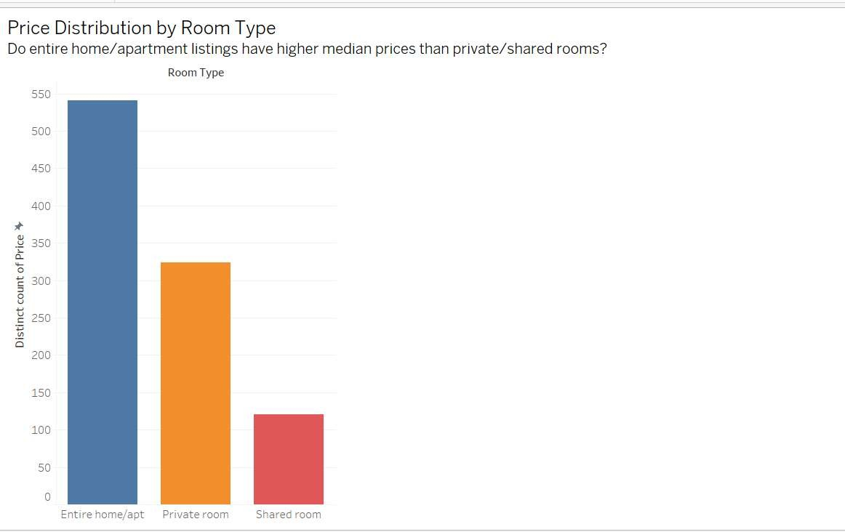
Market Insights: Price & Location
Manhattan highest; Brooklyn next; Queens/Bronx/Staten Island cheape
Entire home/apt ≫ private room ≫ shared room.

Slide 9
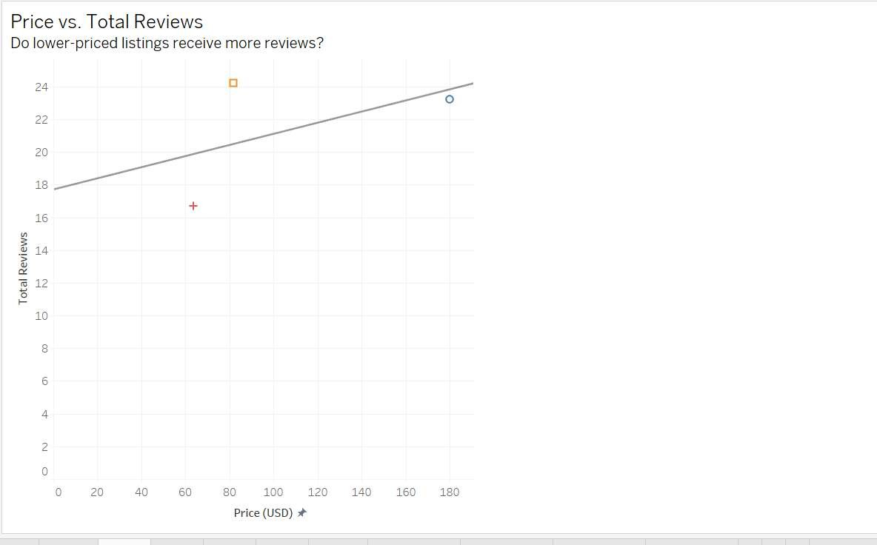
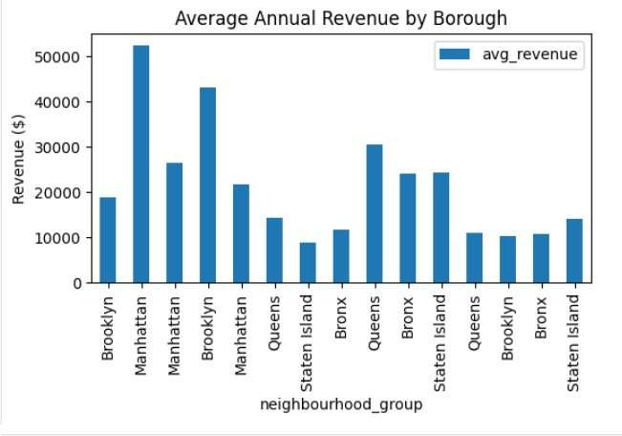
Demand & Revenue Patterns
Lower–moderate prices attract more reviews → higher demand.
Manhattan & Brooklyn generate highest estimated annual revenue per listing.

Slide 10
Module 2: Synthetic Data Generation
Selected key features:
  price, minimum_nights, availability_365, number_of_reviews,
  neighbourhood_group, room_type.
Trained a tabular generative model (copula / GAN-style) on cleaned data.
Generated a synthetic dataset similar in size to real data.
Compared distributions, correlations, and category frequencies (real vs synthetic).

Slide 11
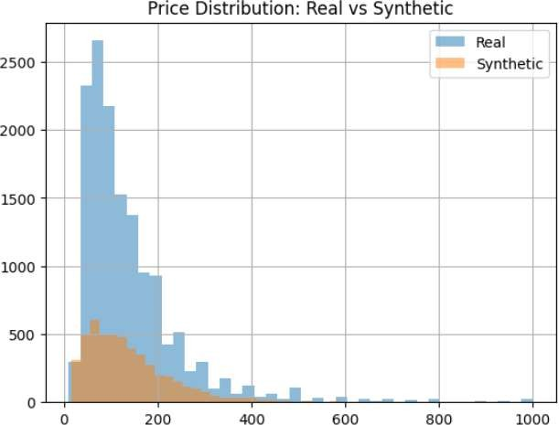
Real vs Synthetic Distributions
Price distribution in synthetic data closely matches real data
  Same right-skew from high-priced Manhattan listings.
Correlations (e.g., price vs neighbourhood_group, reviews vs availability) preserved.
Synthetic data is suitable for what-if experiments and privacy-preserving sharing.

Slide 12
Module 3: Recommendation System
Two mini examples:
Budget traveller (~$100/night, Brooklyn private room):
  Recommender shows active listings with mid-range prices + high reviews + good availability.
Luxury Manhattan guest (high budget, entire home/apt):
  Suggests central Manhattan listings with high prices, frequent reviews, limited availability.
Bottom line: Different guest segments receive transparent, data-driven shortlists instead of scrolling thousands of listings.

Slide 13
Integrated Cloud Pipeline
PySpark-based mining for scalable EDA and feature engineering.
Synthetic data model for privacy-preserving experimentation.
Recommendation engine that operationalises descriptive insights into personalised results.
All components run end-to-end on Databricks, ready to extend across cities and years.

Slide 14
Limitations & Future Work
Only NYC, 2019 → no post-COVID or temporal dynamics.
Use proxy demand (reviews, availability), not true bookings.
Recommender is simplified: content-based only, no user–item interaction history.
Future:
  Multi-city, multi-year data.
  True booking/occupancy data.
  Hybrid collaborative filtering with side info.
  Formal privacy metrics for synthetic data.

Slide 15
Business Recommendations
Business Recommendations
  Provide pricing bands per neighbourhood & room type to guide hosts.
  Surface value neighbourhoods (e.g., good reviews, lower prices) for budget travellers.
  Highlight quality signals (review frequency, availability, host scale) more clearly in UI.
  Maintain a synthetic data sandbox for safe experimentation and policy work.

Slide 16
Conclusion
An integrated cloud analytics pipeline can:
  Explain pricing & demand,
  Generate realistic synthetic data,
  Deliver personalised recommendations.
Approach is scalable and reusable for other cities and time periods.

Slide 17
THANK YOU

